Slide 1

Soldering Station
By Kobe Dieryck
“If a cluttered desk is a sign of a cluttered mind, we cant help wonder what an empty desk indicates” – Albert Einstein
Notes:
Ever wondered how you yourself could make a nonfunctional sleek and nice paperweight

Slide 2
What wanted
Sleek and neat
A small pcb
Jbc C245
Notes:
A neat professional and sleek design, I wanted , ideally a small pcb to avoid making a huge case

Slide 3
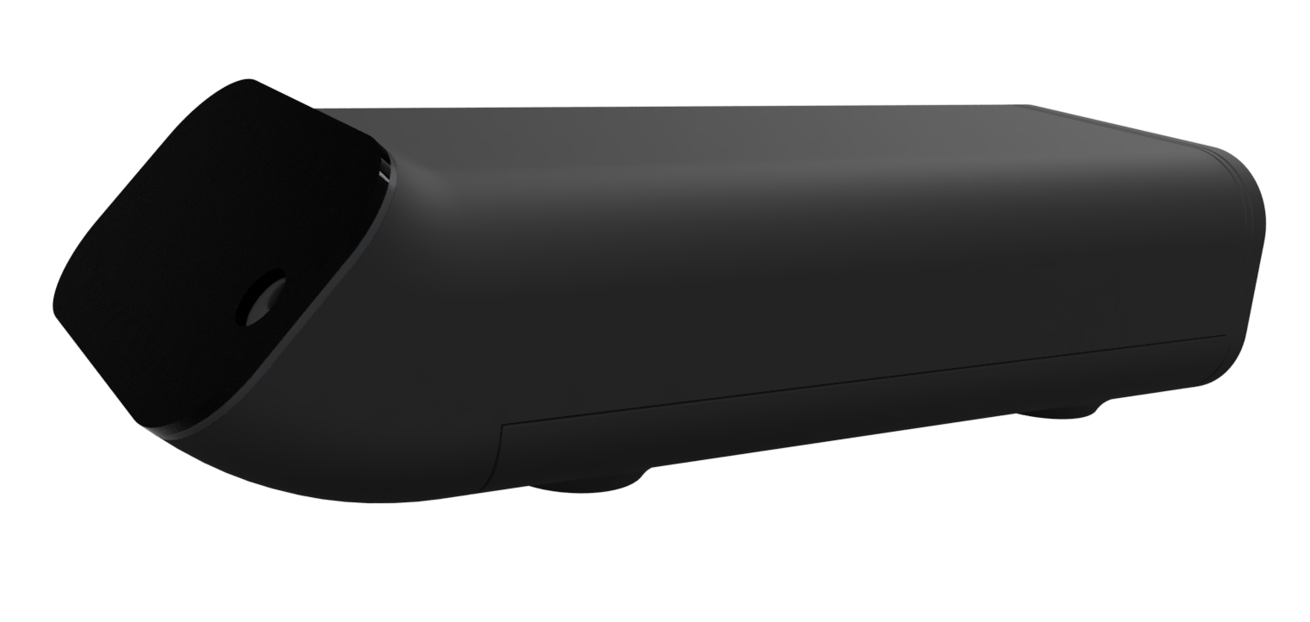
What went well: CAD
Notes:
A neat professional and sleek design, it is a parametric design, so I can change any parameter (hence parametric) like fillet or length height, etcetera

Slide 4
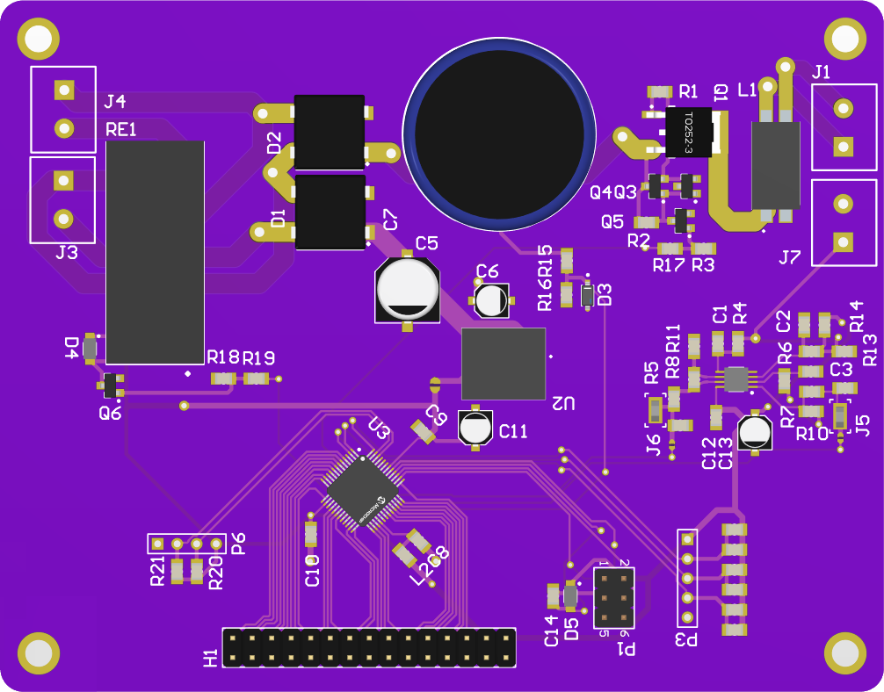
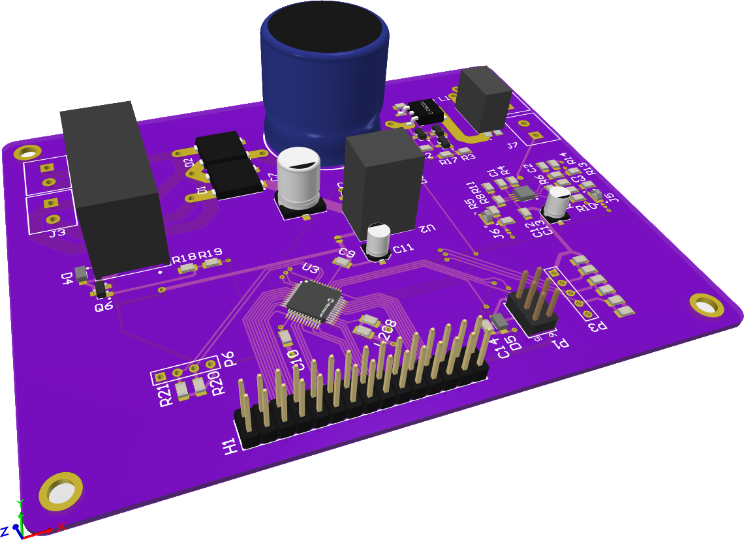
What went well: PCB design
Notes:
I like the compactness of each room (a grouping of components) but the layout could have been better

Slide 5
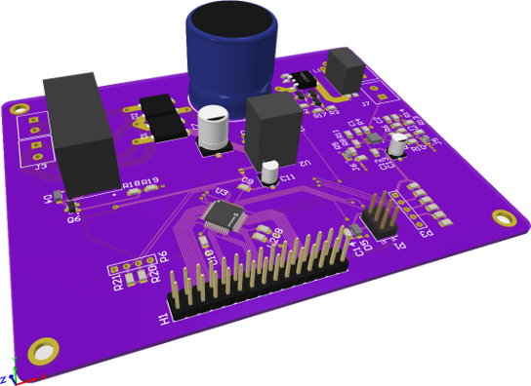
What went well: PCB design
Testing
Open traces
Breakout
Notes:
The testing of the pcb

Slide 6
What went wrong : Soldering
Atmega rework
Opamp
Notes:
The atmega smeared, needed to fix that, while testing power ended up at the input of the atmege, thus destroying it.

Slide 7
What went wrong : Testing
ESD
Tip not warming
Notes:
As I said earlier the atmega died of ESD, and the tip did not warm up

Slide 8
What went wrong : PCB design
Testpoints and Solderbridges
Spacing
Notes:
After reflection, the pcb more testpoints, so I could analyze out what went wrong , needed more solderbridges to isolate | spacing of components were not even

Slide 9
Result
How do I improve?
Notes:
More testpoints and solderbridges, place stencil more carefull . Don’t place power on opamp

Slide 10
Thank you for your attention!

